Slide 1
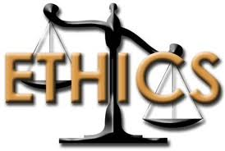
Stages of Moral Development
By
Prof. Parul Rishi, PhD, Psychology
Faculty of HRM, IIFM, Bhopal
(Ministry of Environment Forest and Climate Change, GoI)

Slide 2
Let’s Experience….
MD Scale- An Experiential Exercise for Judges
Situation
What will you do in this Situation????
Instructions: Please read the given simulated scenario and try to see yourself in that very situation. Whatever is your first likely response, give number 1 in the box, followed by 2 and 3.You are requested to write number in all the three boxes of each statement.

Slide 3
Where are ethics?
Written in Judiciary’s code of conduct ? (Nolan Principles/Bangalore Values)
Enforced by law?
In our minds?

Slide 4
Who makes us Ethical or Otherwise?
Our Values
Our Culture
Our Mind set

Slide 5
Individual Characteristics Affecting Ethical Behaviors
Values
Basic convictions about what is right or wrong on a broad range of issues

Slide 6
Values vs. Morals vs. Ethics
The terms "values," "morals" and "ethics, operate at three normative levels:
Values- defined by oneself,
Morals- by society
Ethics- organization or by subgroups of society.
The philosophy behind all the three is to distinguish between right and wrong.

Slide 7
World of Values
Ethics
Values

Slide 8
Values in Conflict?
STATED VALUES: The values stated in written documents like Bangalore principles of Judicial Conduct or Nolan principles
OPERATIONAL VALUES: The values that actually drive judicial decisions.
Many times there a disconnect between the two while taking decisions.
Why this disconnect???

Slide 9
Many times we do not know that we are doing something unethical Who will tell you that you are doing something unethical?? The answer is__

Slide 10
Ask your self! If you feel a minutest fear in your mind that what will happen if someone knows about it that it is done with some wrong intention? Don’t do it considering it as the voice of your conscience to save you. This is the best check to test whether a behaviour is ethical or not

Slide 11
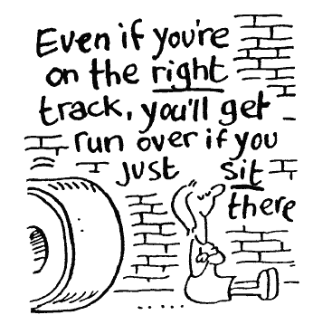
Threats to Morality –
External Pressures to threat or benefit, Humanitarian concerns, Attitudes and biases…

Slide 12
Why it is difficult to be ethical??

Slide 13
Myth vs.Reality of Ethics
It is easy to be ethical.
-Smell Test. If something stinks, don’t do it.
- Consequential Framework
(Consequence –Benefit/Harm to society)
- Deontological Framework
(Justice, rights and virtue with emphasis on integrity of actor)
Ex- Child Labour and prostitution in developing countries
Case on Ban on Bar dance in Mumbai and later on lifting it. (The controversial law banning dance bars in Maharashtra, which provided employment to thousands of women, was put on hold by the Supreme Court )2015.

Slide 14
Myth vs.Reality
Unethical Behaviour is simply the result of bad apples
Ethics in Judiciary can be managed through Ethical Codes
Ethical behavior is linked to Ethical Leadership
People are less ethical than they used to be

Slide 15
Dots Puzzle – Connect all the nine dots with your pen in four consecutive lines without lifting your pen.
. | . | .
. | . | .
. | . | .

Slide 16
Instructions
Join all the 9 dots
With 4 straight lines
Without lifting the pen
No dot should be left unconnected

Slide 17
Dots Puzzle- Solution
. | . | .
. | . | .
. | . | .

Slide 18
Learning from 9 Dot Puzzle
All dots in cases are not so simple to connect.
Some cases challenge our mental capacity in order to take right judgment.
We have to go beyond logical sequence of events to adopt out of box thinking.
See beyond what your eyes can see
Listen beyond what your ears can hear
Feel beyond what your mind says
Move from Logical to lateral thinking
THE ROAD NOT TAKEN

Slide 19
Ethical Dilemmas
Judges confront real ethical dilemmas
Ethical dilemmas are situations in which none of the available alternatives seems ethically acceptable to write a judgment.
The ethical obligations of giving any judgment keeping in mind human rights, corruption, environment and societal concerns.

Slide 20
Components of Personality
Sigmund Freud
ID
EGO
SUPER EGO

Slide 21
Ethical and Unethical Decision Making

Slide 22
Individual Characteristics
Personality Variables
Ego strength
A personality measure of the strength of a person’s convictions(Will Power)
Locus of Control
A personality attribute that measures the degree to which people believe they control their own life.
Internal locus: the belief that you control your destiny.
External locus: the belief that what happens to you is due to luck or chance.

Slide 23
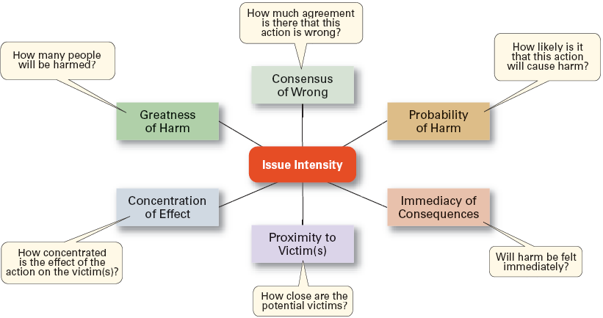
Determinants of Issue Intensity

Slide 24
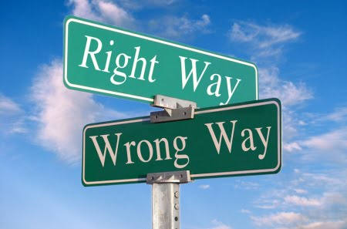
Lawrence Kohlberg: Stages of Moral Development

Slide 25
Moral Development
Moral development is the gradual development of an individual’s concept of right or wrong, conscience, religious values, social attitudes and behaviour.

Slide 26
Three Categories of Morality
Moral
Ethical and moral principles
Immoral
Intentionally Amoral vs
Unintentionally Amoral
Amoral

Slide 27
Levels of Moral Development
Principled
Conventional
Pre-conventional

Slide 28
Stages of Moral Development

Slide 29
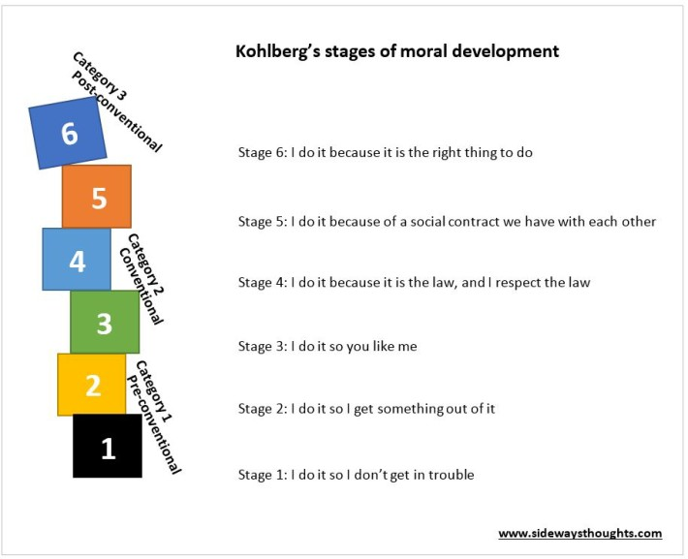

Slide 30
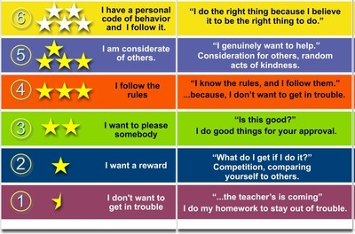
Stages of Moral Development

Slide 31
Stage 1: Fear of Punishment
Not law or justice, but cost to me
Conscience = self-protection

Slide 32
Stage 2: Profit
Minimize the pain; maximize the pleasure
Right behavior means acting in one's own best interests.
Reasoning is largely based on an attitude of “you scratch my back and I’ll scratch yours.”
Conscience = cunning

Slide 33
Level Two: The Conventional Level
Description:
A person’s moral reasoning involves maintaining the expectations of one’s family, peer group, or nation for one’s own sake regardless of the immediate consequences, and a desire to respect, maintain, support, and justify the existing social order.

Slide 34
Stage 3: Group Loyalty
Obligation to ones family, gang, etc.
One earns acceptance by being “nice.”
Behavior is often judged by intention – “Well, they mean well.”
Conscience = loyalty

Slide 35
Stage 4: Law and Order
Without laws, society would be chaos
Right behavior consists of doing one’s duty and respecting authority.
Flaws in the system are due to the failure of individuals who do not obey the system.
Conscience = good citizenship

Slide 36
Level Three: Post Conventional Level- Internalized-Truth-Centered
Description:
A person reasons according to moral values and principles which are valid and applicable apart from the authority of the groups.
Moral reasoning becomes more comprehensive, reflects universal principles, and is based on internalized norms.

Slide 37
Moral Development
Research Conclusions:
People proceed through the stages of moral development sequentially.
There is no guarantee of continued moral development.
Myth: Most adults are in principled stage (“good corporate citizen”).
It is quite possible for a human being to physically mature but not morally mature.

Slide 38
Kohlberg believed that only about 25% of persons ever grow to level six, the majority remaining at level four.
The Scriptures speak of principles of modesty, humility, and wise stewardship of money.
If Kohlberg’s observations are true, then level 6 thinkers would be in the minority. In fact, they might even be misunderstood and persecuted by a level 4 majority .

Slide 39
Lets know where we are?
A- Conventional Stage of Moral Development
B-Principled Stage
C-Pre Conventional Stage
Lowest Score is dominant stage of Moral Development.

Slide 40
Choosing a Pebble What these pebbles teach us?

Slide 41
Features of Pebbles
Different shapes and sizes
Different colours
Largest at the bottom
Smallest at the top
All connected
All balanced on each other

Slide 42
Lessons from Pebbles
Come across cases from diverse sections of society- Caste, Class,religion,age groups
Need to balance the interests of all through values for fairness and impartiality overcoming the individual attitudes and biases.
Largest stone acting as a base for judiciary
Responsibility to keep all the courts down the line connected with judicial values
Responsibility to make sure that smallest one on the top is not felling down due to any imbalance.
If they stand strong and connected, no one can roll them in their own way.

Slide 43
Morality and Values Percolate from Top to Bottom

Slide 44
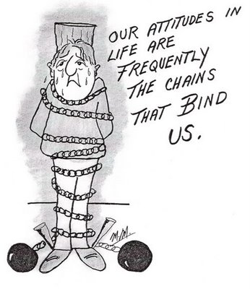

Slide 45
Thank You

